Slide 1
Imarticus – Capstone Project
Credit Card Fraud Detection using Logistic Regression

Slide 2

Project Overview
Objective: Classify transactions as fraudulent or legitimate
Model Used: Logistic Regression
Goal: Establish a strong baseline for fraud detection

Slide 3
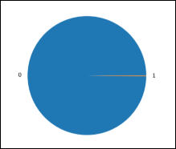
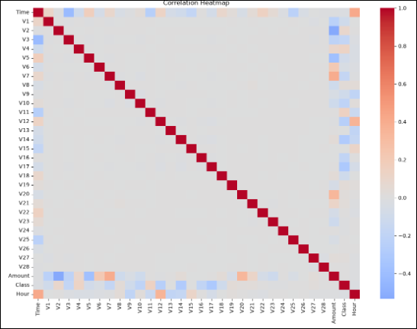
Data Exploration
Dataset: Highly imbalanced (fraud vs. legitimate)
Steps: Missing value check, correlation analysis, visualization
Insights: Fraud cases <1% of total transactions

Slide 4
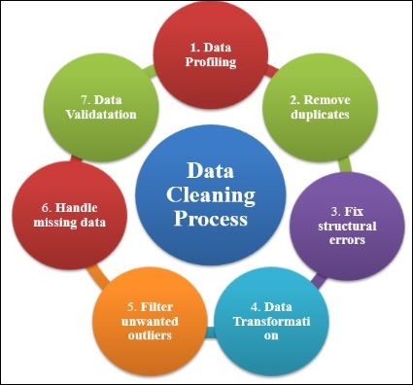
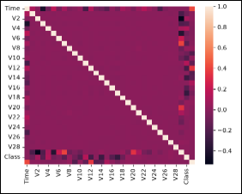
Data Preprocessing
Feature scaling (Standard Scaler)
Handling imbalance (SMOTE / under sampling)
Feature engineering for improved model accuracy

Slide 5
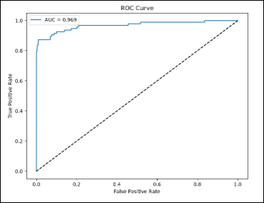
Model Development
Algorithm: Logistic Regression
Training: Split into train/test sets
Evaluation metrics: Accuracy, Precision, Recall, F1‑Score, ROC‑AUC
Results
Image: ROC curve chart
Strong baseline performance despite imbalance
High precision and recall for fraud detection
ROC‑AUC curve shows robust classification ability

Slide 6

Future Scope
Compare with Random Forest, XGBoost, Neural Networks
Optimize threshold tuning and feature selection
Deploy for real‑time fraud monitoring

Slide 7

Conclusion – Credit Card Fraud Detection
This project developed a Credit Card Fraud Detection system using Logistic Regression. The dataset was cleaned, explored through exploratory data analysis, and preprocessed using feature scaling and feature engineering. Logistic Regression was selected due to its effectiveness for binary classification. The model was evaluated using Accuracy, Precision, Recall, F1-score, ROC-AUC, and the Confusion Matrix. The results demonstrate that Logistic Regression is capable of accurately identifying fraudulent transactions while maintaining a low false positive rate. Although fraud detection remains challenging because of severe class imbalance, the model provides a reliable baseline that can support financial institutions in detecting suspicious transactions and reducing fraud-related losses.

